Slide 1

Presentation III
Research Idea Discussion
Thu Ta Zaw
2415121095

Slide 2

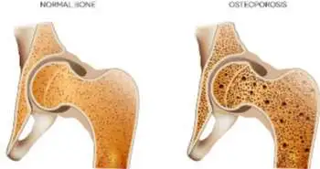
Background of Osteoporosis
Background and effects
Osteoporosis is a skeletal disease characterized by low bone mass and microarchitectural deterioration.
Can cause bone fragility and increased fracture risk.
Around 200 Million people are affected.
Can cause long-term disability and mortality.
Current Diagnostic Limitations
DXA (Dual energy X-ray Absorptiometry) is not suitable for repeated monitoring.
BMD only measure bone mineral density
Bone microarchitecture, porosity and composition are key to strength but are not captured by BMD.
Fig. Comparison of healthy bone and bone with osteoporosis
5

Slide 3
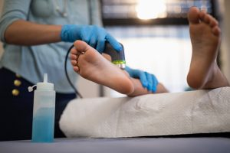
Tibial cortical Porosity estimation via ultrasound
Background
Integrating acoustic, optical and depth-sensing technologies for bone health assessment.
It is a radiation-free, portable and quantitative diagnostic tools.
Can measure microstructure and composition.
Current Diagnostic Limitations
Ultrasound to measure the cortical thickness and porosity by using the speed of sound.
DXA can only gives areal BMD and cannot see porosity or bone quality.
Fig. Bone Scanning using Ultrasound
5

Slide 4
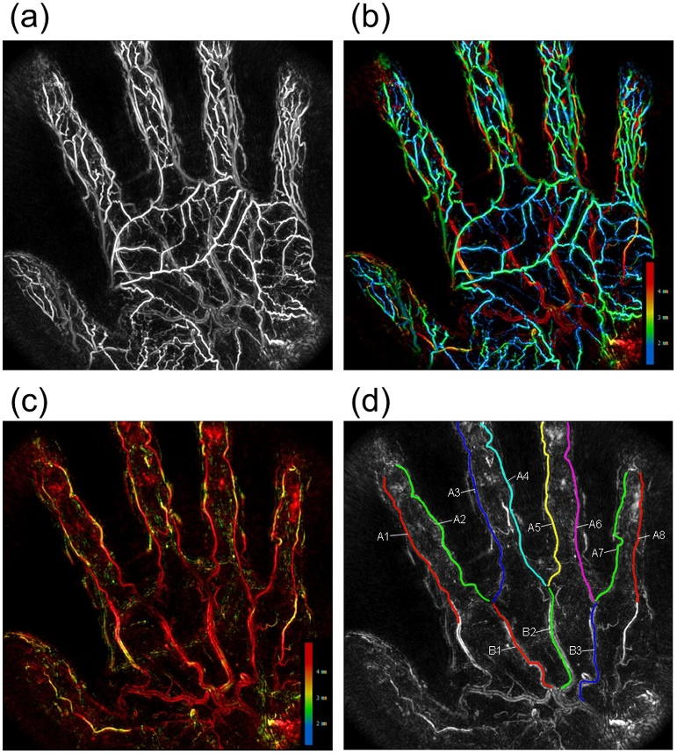
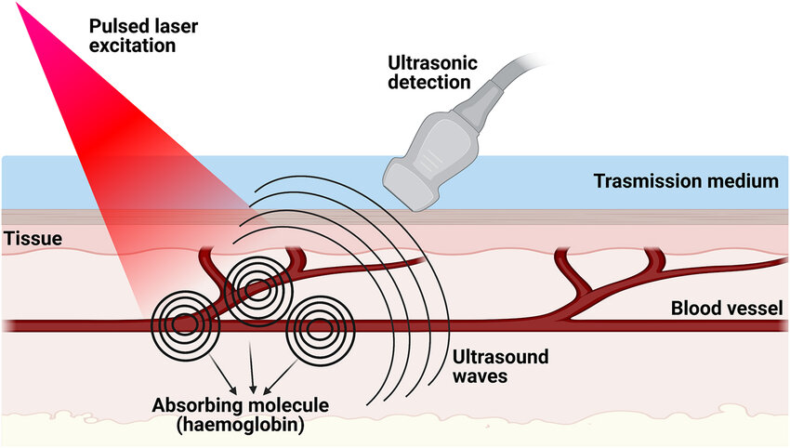
Photoacoustic Imaging (PAI) of bone marrow health
Background
Non-invasive markers of bone marrow perfusion and oxygenation to complement density and microstructure.
Can be served as early biomarkers of bone remodeling and therapy response.
Current Diagnostic Limitations
DXA cannot scan blood, and bone is highly vascular, and perfusion changes precede density changes.
PAI can provide optical contrast with ultrasound resolution, and can help with early detection
Fig. Photoacoustic Imaging
Fig. Photoacoustic Imaging Mechanism
5

Slide 5
Geometry-Aware Near Infrared Optical Sensing using LiDAR fusion
Background
Optical system that uses Near-Infrared (NIR) light for tissue spectroscopy and LiDAR for geometry correction to estimate bone cortical thickness.
LiDAR for geometry correction to estimate bone cortical thickness.
Can provide personalized optical path.
Can improve the accuracy in estimating underlying bone properties.
Experimental workflow
LiDAR scans Region of interest and perform surface mesh and compute local and normal curvature.
NIR will use to capture the bone by penetrating the skin tissue.
5

Slide 6
AI-based Fracture Risk prediction from Routine X-rays
Concept
Train CNN models on chest, hand, or dental X-rays to indirectly estimate bone mineral density (BMD) without DXA.
Can learn bone-quality features from the existing X-rays data to train the DXA model.
Experimental workflow
To develop a deep learning model that takes routine radiographs as input and outputs.
Can predict the probability of osteoporosis and estimate the fracture risk.
Visual heatmap highlighting weak bone regions.
Will use weakly supervised learning using the patient has osteoporosis rather than exact pixel-level bone annotations.
5

Slide 7
Improvement Idea on Non-Invasive Skin Phantom Properties Estimation using air-jet indentation.
Concept
Introduce AI-based inverse modeling to predict phantom or skin stiffness directly from LiDAR depth maps.
Add mass flow control (MFC) or PWM-controlled solenoid for pulse shaping.
Add pressure feedback sensor to record real-time pressure near nozzle.
Calibrate two LiDAR at offset angle for improved accuracy and shadow compensation.
Improve repeatability by improving calibration.
Performing simulation validation model using FEM.
5

Slide 8
The End
THANK YOU FOR LISTENING
Thu Ta Zaw
2415121095

